Slide 1
601.465/665
Natural Language Processing
Prof: Jason Eisner
Webpage: http://cs.jhu.edu/~jason/465
syllabus,
announcements,
slides,
homeworks

Slide 2
Goals of the field
Computers would be a lot more useful if they could handle our email, do our library research, talk to us …
But they are fazed by natural human language.
How can we tell computers about language? (Or help them learn it as kids do?)
600.465 – Intro to NLP – J. Eisner

Slide 3
A few applications of NLP
Spelling correction, grammar checking …
Better search engines
Information extraction
Psychotherapy; Harlequin romances; etc.
New interfaces:
  Speech recognition (and text-to-speech)
  Dialogue systems (USS Enterprise onboard computer)
  Machine translation (the Babel fish)
600.465 – Intro to NLP – J. Eisner

Slide 4
Goals of the course
Introduce you to NLP problems & solutions
Relation to linguistics & statistics
At the end you should:
  Agree that language is subtle & interesting
  Feel some ownership of the formal & statistical models
  Have new perspectives and habits of mind
  Understand research papers in the field
600.465 – Intro to NLP – J. Eisner

Slide 5


Caveat Auditor
(listener beware)
Last year on Piazza: “Thank you all for the amazing class! I truly feel like I’ve learned enough for 3 classes combined, and that this is the class that made my undergrad at Hopkins worth it.”
To learn all of that, the workload is high ☹
  Learn by doing – assignments will take time
  We do give 4 credits, and grading is set slightly high
  We’re always looking for ways to reduce workload
  There are always objections when we try to cut topics
600.465 – Intro to NLP – J. Eisner

Slide 6
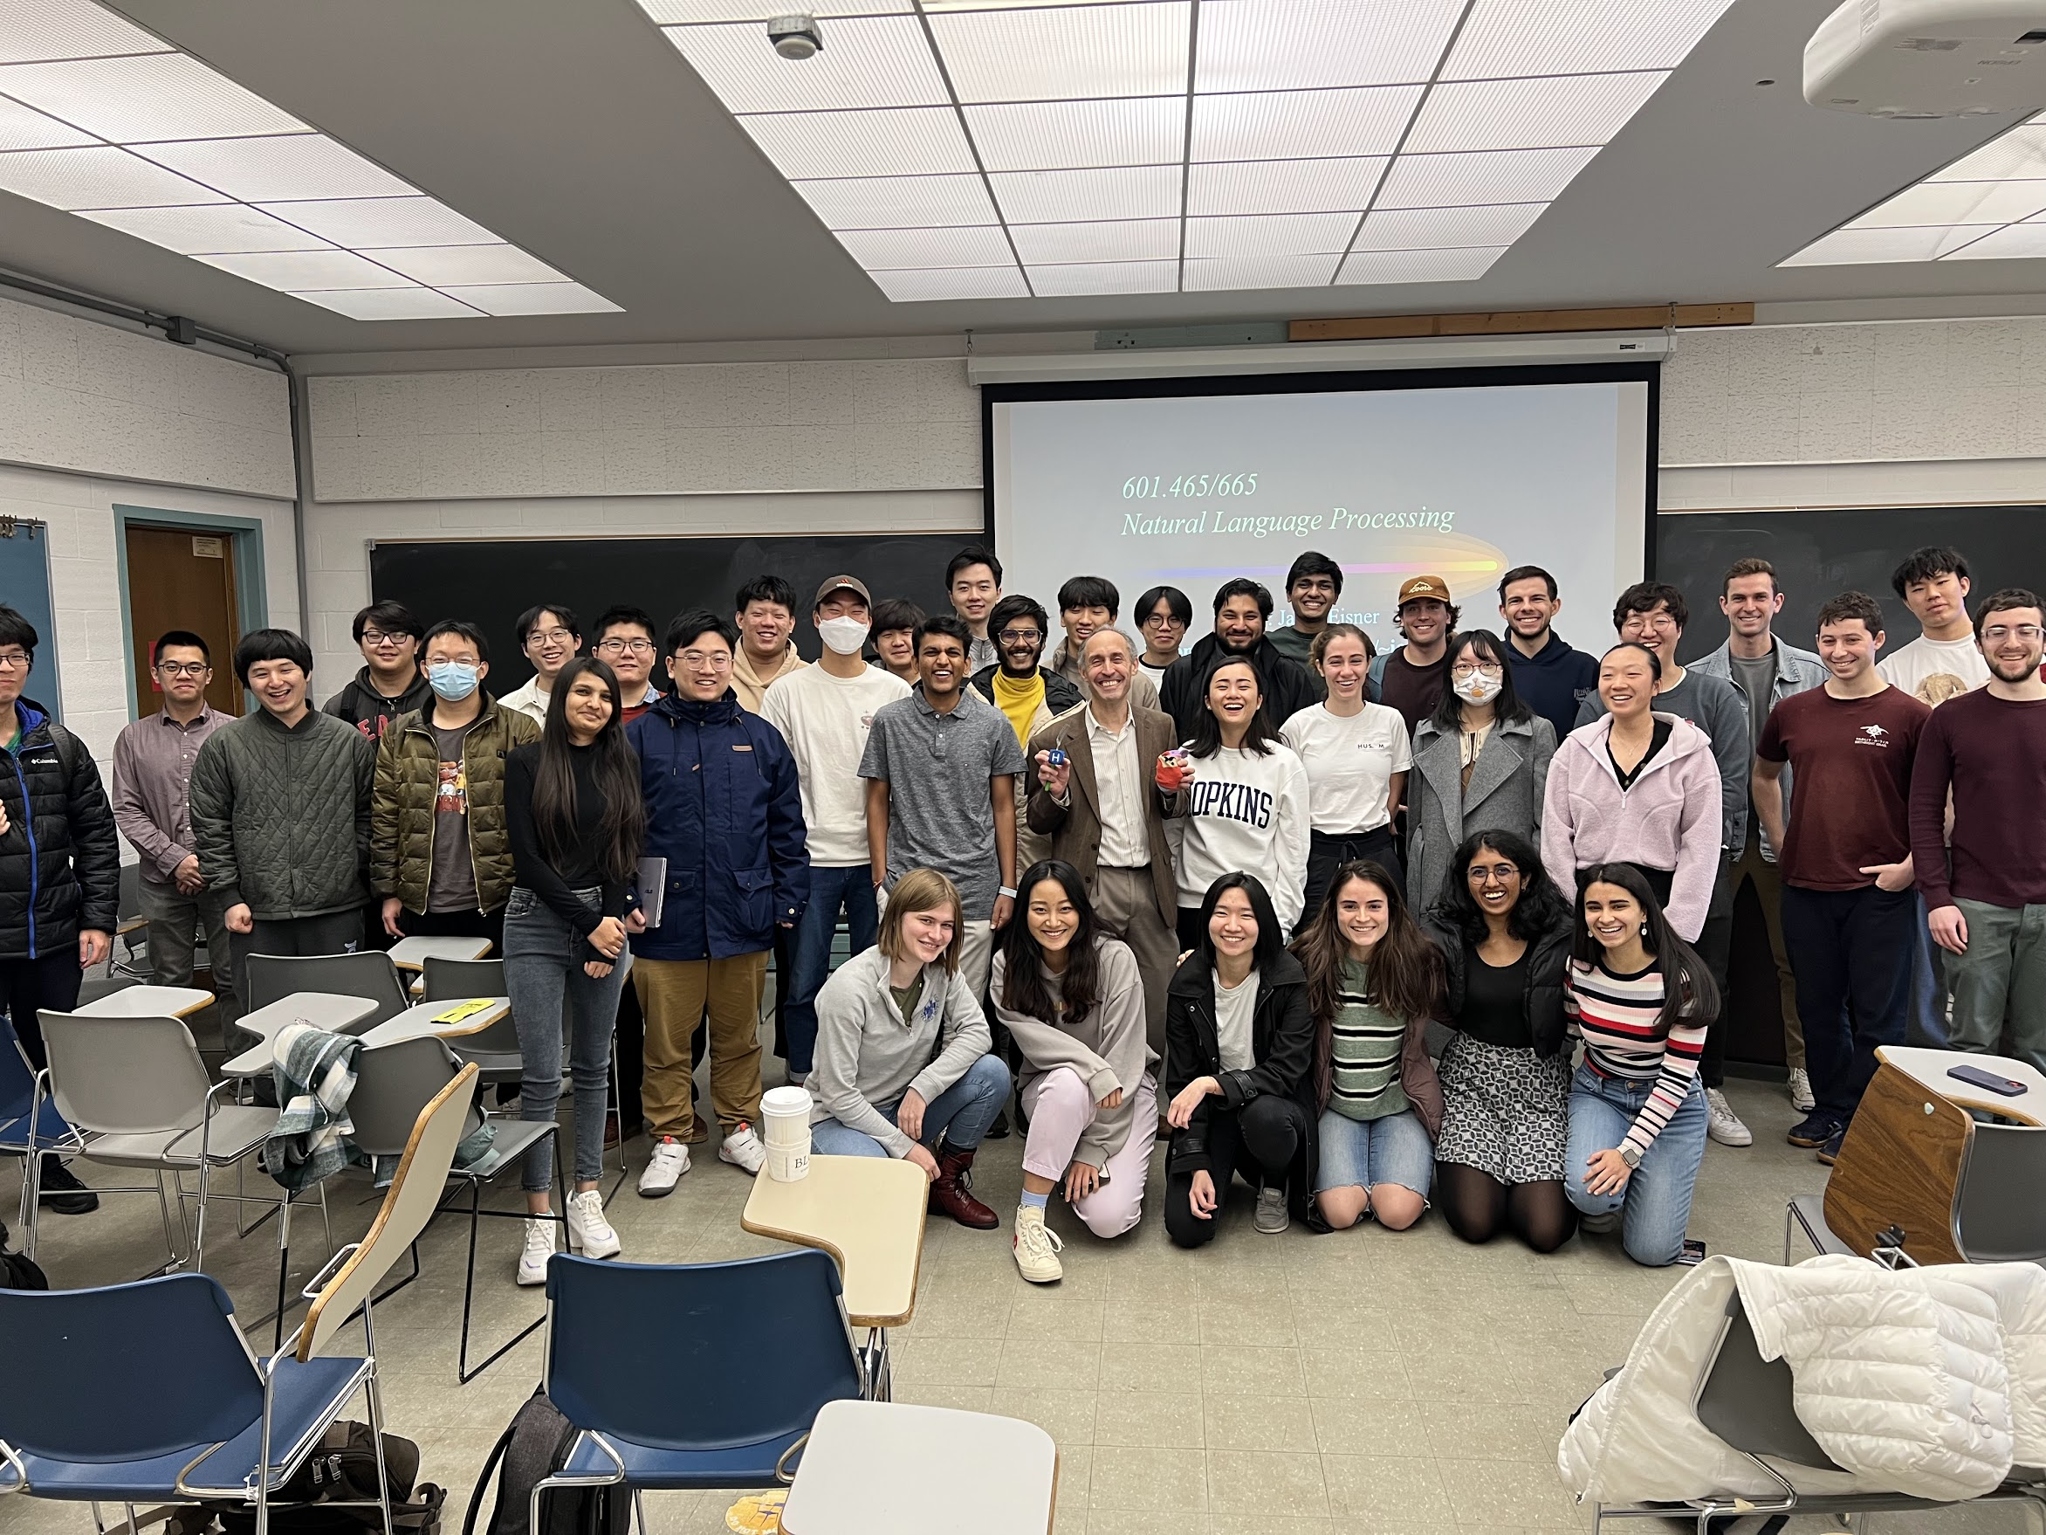
Fall 2022
600.465 – Intro to NLP – J. Eisner

Slide 7
Ambiguity: Favorite Headlines
Iraqi Head Seeks Arms
Is There a Ring of Debris Around Uranus?
Juvenile Court to Try Shooting Defendant
Teacher Strikes Idle Kids
Stolen Painting Found by Tree
Kids Make Nutritious Snacks
Local HS Dropouts Cut in Half
Obesity Study Looks for Larger Test Group
600.465 – Intro to NLP – J. Eisner

Slide 8
Ambiguity: Favorite Headlines
British Left Waffles on Falkland Islands
Never Withhold Herpes Infection from Loved One
Red Tape Holds Up New Bridges
Man Struck by Lightning Faces Battery Charge
Clinton Wins on Budget, but More Lies Ahead
Hospitals Are Sued by 7 Foot Doctors
600.465 – Intro to NLP – J. Eisner

Slide 9
Levels of Language
Phonetics/phonology/morphology: what words (or subwords) are we dealing with?
Syntax: What phrases are we dealing with? Which words modify one another?
Semantics: What’s the literal meaning?
Pragmatics: What should you conclude from the fact that I said something? How should you react?
600.465 – Intro to NLP – J. Eisner

Slide 10
Subtler Ambiguity
Q: Why does my high school give me a suspension for skipping class?
A: Administrative error. They’re supposed to give you a suspension for auto shop, and a jump rope for skipping class. (*rim shot*)
600.465 – Intro to NLP – J. Eisner
Notes:
Who saw that coming?
Well, that’s what’s amazing about you. You jumped right to the right interpretation. You knew which meanings were plausible in this context for the words suspension, skip, for. You knew that skipping class was a kind of skipping, not a kind of class. How’s your computer going to know that?

Slide 11
What’s hard about this story?
John stopped at the donut store on his way home from work. He thought a coffee was good every few hours. But it turned out to be too expensive there.
600.465 – Intro to NLP – J. Eisner

Slide 12
What’s hard about this story?
John stopped at the donut store on his way home from work. He thought a coffee was good every few hours. But it turned out to be too expensive there.
To get a donut (spare tire) for his car?
600.465 – Intro to NLP – J. Eisner

Slide 13
What’s hard about this story?
John stopped at the donut store on his way home from work. He thought a coffee was good every few hours. But it turned out to be too expensive there.
store where donuts shop? or is run by donuts?
or looks like a big donut? or made of donut?
or has an emptiness at its core?
600.465 – Intro to NLP – J. Eisner

Slide 14
What’s hard about this story?
I stopped smoking freshman year, but
John stopped at the donut store on his way home from work. He thought a coffee was good every few hours. But it turned out to be too expensive there.
600.465 – Intro to NLP – J. Eisner
Notes:
donut = spare tire?
donut store = store that is run or patronized by donuts? or looks like a big donut? or made of donuts? or has an emptiness at its core?

Slide 15
What’s hard about this story?
John stopped at the donut store on his way home from work. He thought a coffee was good every few hours. But it turned out to be too expensive there.
Describes where the store is? Or when he stopped?
600.465 – Intro to NLP – J. Eisner
Notes:
donut = spare tire?
donut store = store that is run or patronized by donuts? or looks like a big donut? or made of donuts? or has an emptiness at its core?

Slide 16
What’s hard about this story?
John stopped at the donut store on his way home from work. He thought a coffee was good every few hours. But it turned out to be too expensive there.
Well, actually, he stopped there from hunger and exhaustion, not just from work.
600.465 – Intro to NLP – J. Eisner
Notes:
donut = spare tire?
donut store = store that is run or patronized by donuts? or looks like a big donut? or made of donuts? or has an emptiness at its core?

Slide 17
What’s hard about this story?
John stopped at the donut store on his way home from work. He thought a coffee was good every few hours. But it turned out to be too expensive there.
At that moment, or habitually?
  (Similarly: Mozart composed music.)
600.465 – Intro to NLP – J. Eisner
Notes:
donut = spare tire?
donut store = store that is run or patronized by donuts? or looks like a big donut? or made of donuts? or has an emptiness at its core?

Slide 18
What’s hard about this story?
John stopped at the donut store on his way home from work. He thought a coffee was good every few hours. But it turned out to be too expensive there.
That’s how often he thought it?
600.465 – Intro to NLP – J. Eisner
Notes:
donut = spare tire?
donut store = store that is run or patronized by donuts? or looks like a big donut? or made of donuts? or has an emptiness at its core?

Slide 19
What’s hard about this story?
John stopped at the donut store on his way home from work. He thought a coffee was good every few hours. But it turned out to be too expensive there.
But actually, a coffee only stays good for about 10 minutes before it gets cold.
600.465 – Intro to NLP – J. Eisner
Notes:
donut = spare tire?
donut store = store that is run or patronized by donuts? or looks like a big donut? or made of donuts? or has an emptiness at its core?

Slide 20
What’s hard about this story?
John stopped at the donut store on his way home from work. He thought a coffee was good every few hours. But it turned out to be too expensive there.
Similarly: In America a woman has a baby every 15 minutes. Our job is to find that woman and stop her.
600.465 – Intro to NLP – J. Eisner
Notes:
donut = spare tire?
donut store = store that is run or patronized by donuts? or looks like a big donut? or made of donuts? or has an emptiness at its core?

Slide 21
What’s hard about this story?
John stopped at the donut store on his way home from work. He thought a coffee was good every few hours. But it turned out to be too expensive there.
the particular coffee that was good every few hours? the donut store? the situation?
600.465 – Intro to NLP – J. Eisner
Notes:
donut = spare tire?
donut store = store that is run or patronized by donuts? or looks like a big donut? or made of donuts? or has an emptiness at its core?

Slide 22
What’s hard about this story?
John stopped at the donut store on his way home from work. He thought a coffee was good every few hours. But it turned out to be too expensive there.
too expensive for what? what are we supposed to conclude about what John did?
how do we connect “it” to “expensive”?
600.465 – Intro to NLP – J. Eisner
Notes:
donut = spare tire?
donut store = store that is run or patronized by donuts? or looks like a big donut? or made of donuts? or has an emptiness at its core?

Slide 23
n-grams
Letter or word frequencies: 1-grams (= unigrams)
  useful in solving cryptograms: ETAOINSHRDLU…
If you know the previous letter: 2-grams (= bigrams)
  “h” is rare in English (4%; 4 points in Scrabble)
  but “h” is common after “t” (20%)
If you know the previous two letters: 3-grams (= trigrams)
  “h” is really common after “(space) t”
  etc. …
600.465 – Intro to NLP – J. Eisner

Slide 24
Some random n-gram text …
600.465 – Intro to NLP – J. Eisner

